Slide 1
Object-Oriented Programming and Design Methodologies
Fall Semester 2022
Instructor
Mohammad Salman, Dean’s Fellow

Slide 2
Logistics
Lab location has changed from Graphics Lab to Linux Lab.
Some systems have gone for repair – any student who would like to work on their laptops can do so.
Office hours (unchanged thus far)
Monday: 5pm to 6pm.
Wednesday: 4pm to 5pm.
Office Location
Faculty Pod E-105, Room 115
Attendance is manual.

Slide 3
Logistics – Software Tools
Check the Setup Guide on Canvas to install the C++ compiler and SDL.
Install VS Code (if not already) or any code editor or IDE.
Reach out in case of problems in installation within this week.
HW1 will be out by the end of this week.
System issues will not be an excuse for late submission.
Ideally, please be done by Friday this week.

Slide 4
Course Syllabus – Canvas
Link takes you to “Course Syllabus” tab on Canvas.
https://hulms.instructure.com/courses/3244/external_tools/185

Slide 5
Why C++?
Provides high performance and efficiency.
E.g. robotics applications.
It supports object-oriented programming (but not the only one).
C++ is hybrid language.
Offers a lot of freedom while writing programs.
But that also means that, “With great power comes great responsibility”.
Learning a second language or more is possibly not as difficult as learning the first one.
Concepts transfer over.
You’ll develop an appreciation for the nitty-gritty stuff in programming (like memory management).

Slide 6
Why Learn OOP?
Up until now, what we have been doing is procedural programming.
We think about what procedures or functions will be required, and what will be the required data that these procedures will work with.
OOP requires you to think in a brand new way, which could, arguably, be quite intuitive.
Notes:
Hotel mgmt. system.
You think about various functions – book_room(), vacate_room(), show_revenue(), all_room_statuses(), is_occupied(), etc.
OOP tells you to identify models/physical objects/distinct concepts…
In our example, could be bedrooms, hotel_admin, customers, etc.

Slide 7
Why Learn OOP?
OOP requires you to think in a brand new way.
Usually with our programs, we are trying to simulate a real world problem or situation.
So, what if we try to identify the physical objects, models, distinct concepts, etc., and represent them programmatically?
Each object then will have its own behaviors that need to be modeled, and…
… will have some information or data about its own state.
Notes:
Hotel mgmt. system.
You think about various functions – book_room(), vacate_room(), show_revenue(), all_room_statuses(), is_occupied(), etc.
OOP tells you to identify models/physical objects/distinct concepts…
In our example, could be bedrooms, hotel_admin, customers, etc.

Slide 8
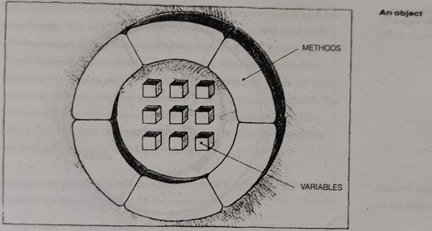
Object
You encapsulate data (attributes) and related methods (functions) together in a single entity.
As such, they can be defined and maintained independently of one another (generally speaking).
Generally, easy to reuse objects than functions/procedures.
Notes:
Hotel mgmt. system.
You think about various functions – book_room(), vacate_room(), show_revenue(), all_room_statuses(), is_occupied(), etc.
OOP tells you to identify models/physical objects/distinct concepts…
In our example, could be bedrooms, hotel_admin, customers, etc.

Slide 9
Why Learn OOP?
OOP is awesome, but isn’t a cure for cancer.
There will be situations where using procedural programming might be suitable, or your only option.
E.g. when you work with a non-object-oriented programming language, e.g. C.
Key takeaway: OOP is based on how we see the world around us – i.e. in terms of objects, entities, concepts, etc.
And then trying to represent them programmatically.

Slide 10
C++ Program Structure and Syntax

Slide 11
A Basic Program
A lot of information can be derived from this simple program.
#include <iostream>
int main()
{
std::cout << "Hello world!!!" << std::endl;
return 0;
}

Slide 12
The “main” Function
Every C++ program will have a main function.
This is the function that is executed first – this is your “main” function.
#include <iostream>
int main()
{
std::cout << "Hello world!!!" << std::endl;
return 0;
}

Slide 13
The “main” Function (contd.)
Instead of indents, braces, i.e. { and }, mark the start and end of a function.
Data type of the return value of the function is specified.
For main(), it will always be int.
More details on functions in a later lecture.
#include <iostream>
int main()
{
std::cout << "Hello world!!!" << std::endl;
return 0;
}

Slide 14
The “main” Function (contd.)
return is part of the function syntax.
The function (main(), in this case) returns the value 0 (an int) to the function caller (compiler or OS in this case) in case of successful completion.
If an error is encountered, some other value will be returned.
#include <iostream>
int main()
{
std::cout << "Hello world!!!" << std::endl;
return 0;
}
Notes:
For example if you forget to write the main() function, the integer 1 will be returned.
Try doing it, and see the output on the terminal.

Slide 15
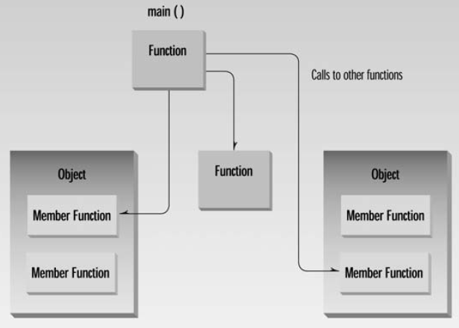
The “main” Function (contd.)
As you write bigger programs, main’s job is to coordinate the different functions in your program.
Your major tasks will end up getting delegated to functions in objects, or other standalone functions.
Figure 2.1 from OOP in C++ by Robert Lafore

Slide 16
Program Statements
Add a semicolon (;) at the end of statements.
Note: std::cout in conjunction with the insertion operator (<<) is used to print content on the screen.
#include <iostream>
int main()
{
std::cout << "Hello world!!!" << std::endl;
return 0;
}

Slide 17
Program Statements (contd.)
Unlike in Python, you generally don’t have to worry about whitespaces.
But don’t compromise the readability of your code.
There are exceptions to this rule though, for e.g.,
#include <iostream> should be on one line.
Etc.

Slide 18
Variables
Discouraged because you don’t know what the value of var_name. – may lead to undefined behavior.
A variable is a memory address where data can be stored and changed.
While creating a variable, you have to specify both its name and its data type (different from Python).
int var_name; // Declaration (discouraged)
int var_name = 3; // Definition/Initialization
int var_name {3}; // Another syntax for intialization

Slide 19
Variable Names (Self Study)
Identifiers -> Names given to variables and other program features.
Upper-case and lower-case letters,
Numbers,
Underscores, hyphens
First character must be a letter or an underscore
Case-sensitive
Cannot use a C++ keyword as an identifier.
if, else, class, int, while, for, …
Identifiers should provide some meaning (num_students, instead of ns).
Be consistent in style (e.g. num_students, or numStudents).

Slide 20
Variable Names (Self Study)
It is not important to define variables at the start of your main function.
You can define it somewhere in the middle of the program whenever the need for that variable arises.
However, variables that are used in many places should preferably be at the start.

Slide 21
Data Types
The compiler wants you to specify (for the most part) data types wherever this information is required, e.g. initializing variables.
Specifying the data type tells the compiler to allocate enough memory to hold a value of this data type.
There are actually a lot of data types, but there are three basic ones.
int (for integers)
char (for single characters and escape sequences, but not strings)
float and double (for floating point values)
Others are variations of these three.
Notes:
e.g. Templates also require the use of data types.

Slide 22
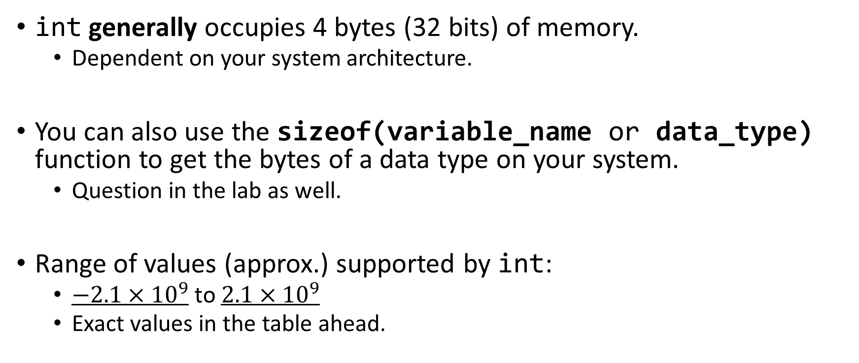
int Type
int num_students = 50;
int num_students {50};
int generally occupies 4 bytes (32 bits) of memory.
Dependent on your system architecture.
You can also use the sizeof(variable_name or data_type) function to get the bytes of a data type on your system.
Question in the lab as well.
Range of values (approx.) supported by int:
$−2.1×{10}^{9}$ to $2.1×{10}^{9}$
Exact values in the table ahead.

Slide 23
Other Integer Types
char, long, short
Size of int is system-dependent.
long and short have fixed sizes.
long occupies 4 bytes; range is same as a 4 byte int.
short occupies 2 bytes; range: –32,768 to 32,767
Note: int accessed faster than short. So use short if you’re low on space.

Slide 24
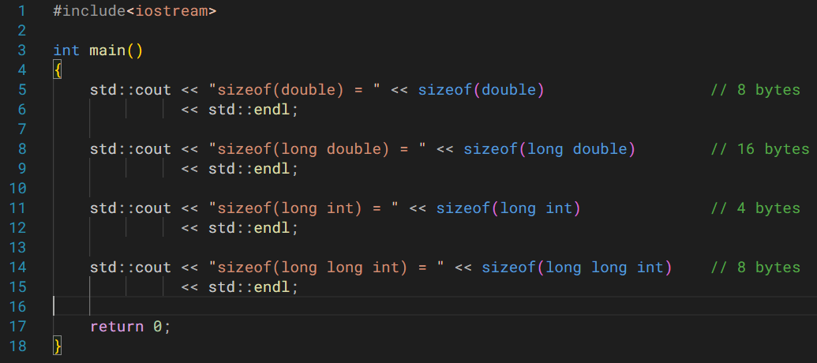
In case you want super big integers, go for long long. Using long long int also seems to work fine.

Slide 25
char type
Stores values in range -128 to 127, generally as ASCII characters.
Occupies 1 byte (8 bits).
What do you think is the output of the following program?
#include<iostream>
int main() {
char f_00 = 123;
std::cout << f_00 << std::endl; // ASCII equivalent character for 123
return 0;
}

Slide 26
char type (contd.)
In order to initialize a char variable,
char first_alphabet = ‘a’;
Note the use of single quotes.
Double quotes are used for writing strings.
Please make a note of this
Notes:
Note: char can be modified to have a bigger range (exceeding -128 to 127), so that it can account for other ASCII characters.
Check Appendix A in your text book (Robert Lafore).

Slide 27
Escape Sequences
‘\n’ , ‘\t’
Although these appear to contain two characters, they represent a single char.
The backslash causes the succeeding character to be interpreted in a different way.
\n -> new line.
\t -> tab
\\ -> backslash
\” -> double quotes
Etc.

Slide 28
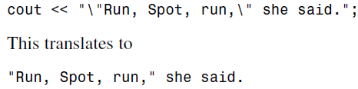
An example on Escape Sequences… Self Study

Slide 29
An example on Escape Sequences… Self Study
You want to distinguish between the double quote that starts/ends the string, and the double quote that you want to output on the screen.

Slide 30
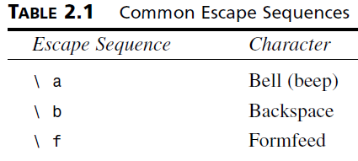
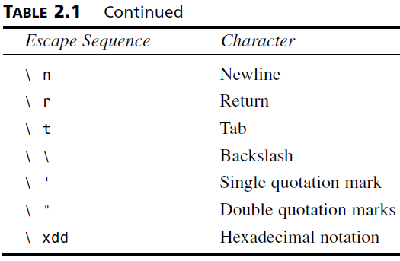
Escape Sequences
Table 2.1 in your textbook (Robert Lafore) for more examples.

Slide 31
Storing Floating Point Numbers
Types int, long, short, and even char, were all representations of integers.
Floating point numbers are decimal values – e.g. 3.142.
Three data types for real numbers
float
double
long double

Slide 32
float type
Also takes up 4 bytes like int.
Range is roughly between 3.4E–38 to 3.4E38.
Precision is 7 digits.
float pi_value {3.14159f}; // OK
float light_speed = 2.99E8f; // Exponentials - OK
float absolute_zero = -273.15f // OK
float some_num = -34f; // NOT OK
For this example, you need to specify -34.0F in order for it to count as a float value.
Also check in your systems.
Both capital F, and lowercase f work.

Slide 33
double and long double types
Similar to float, except the storage, range and precision is higher.
Type double
Size: 8 bytes
Range: 1.7E–308 to 1.7E308
Precision: 15 digits
Type long double
Generally it is the same as double, but is compiler-dependent.
On my system, they are different.

Slide 34
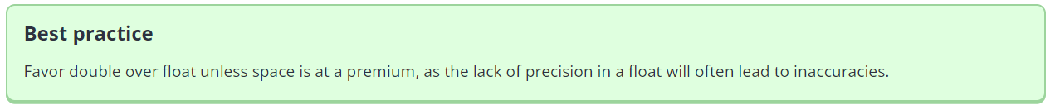
Used from one of the lectures on https://www.learncpp.com/

Slide 35
Note for floating point numbers
In general, avoid doing a comparison between two floating point numbers/variables if you can.
Especially if the values are very close together.
Example on the next slide.
At times there are rounding and/or precision errors that may result in unexpected outputs.

Slide 36
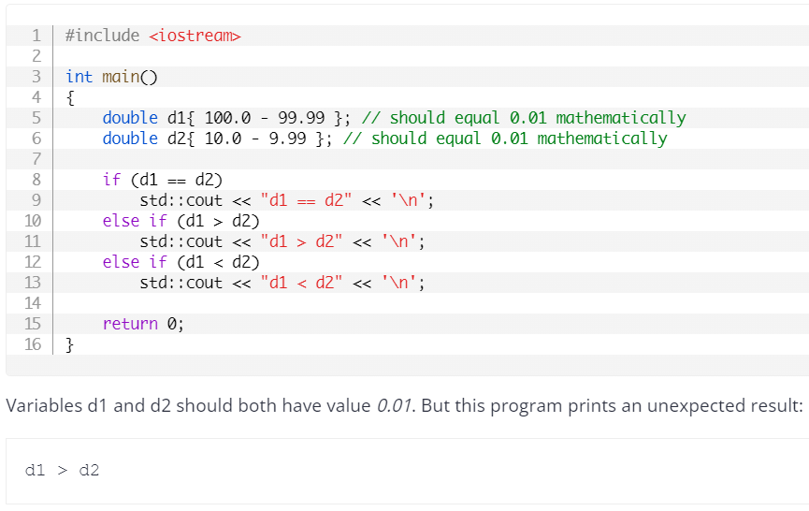
Example to Complement the Previous Note

Slide 37
bool type
1 byte of storage.
Only two possible values – true or false.
Note the syntax for these values.

Slide 38
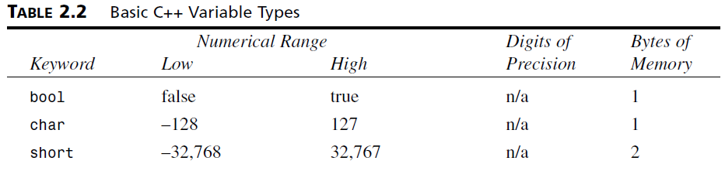
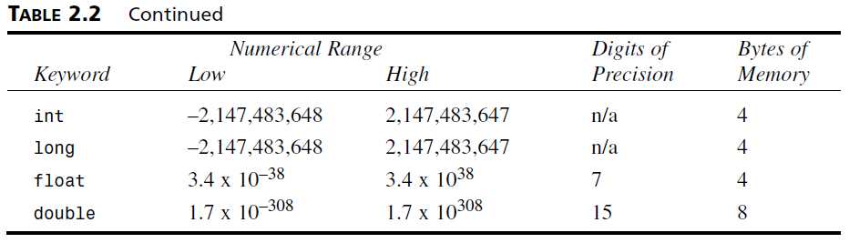
Summary of Data Types

Slide 39
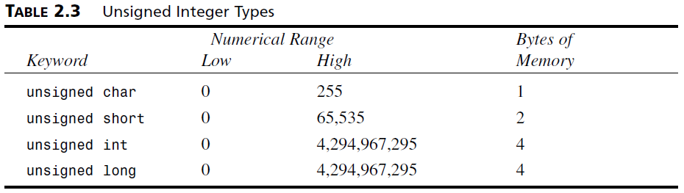
unsigned Data Types
For integer types, you can increase the positive range of those types by ignoring the negative values.
Useful when working with positive-only data (distance, mass, volume, speed, etc.).

Slide 40
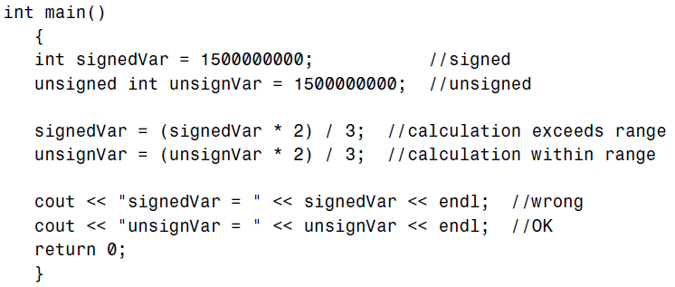

unsigned Data Types (contd.)
Use unsigned versions when you suspect that you will deal with large numbers.
You could also consider using long long instead of just int.

Slide 41
Type Conversions – Automatic
We saw in the lab that if you have two int variables (or literals), and you perform an arithmetic operation (e.g. division), the result will be another int.
14 / 5 = 2 // Instead of 2.8
But what if the data types are different?
14 / 5.0 = ? // int / double
14.0 / 5 = ? // double / int
Automatic (or implicit) type conversion!!!

Slide 42
Type Conversions – Automatic
#include<iostream>
int main ()
{
int count = 10;
float avgWeight = 15.6F;
double totalWeight = count * avgWeight;
std::cout << "Total Weight = " << totalWeight << std::endl;
return 0;
}
Note that count is an int and avgWeight is a float, and together, the result is being stored in a double.

Slide 43
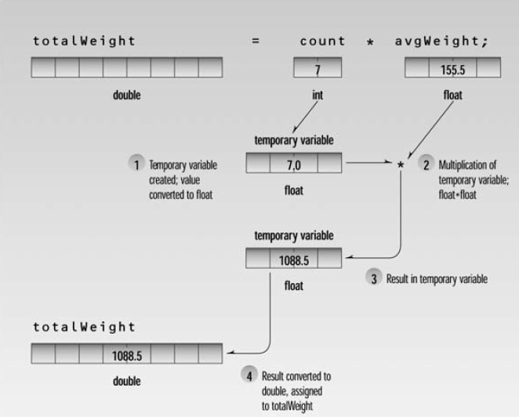
Type Conversions – Automatic (contd.)
Figure 2.9 from OOP in C++, by Robert Lafore

Slide 44
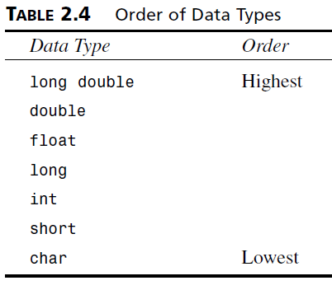
Type Conversions – Automatic (contd.)
The following table shows which data types get upgraded when an operator deals with two different data types.
Lower gets converted to higher.
Automatically done for us by the compiler.

Slide 45
Type Conversions - Casting
When compiler doesn’t do it for us, we use casting.
We’ll talk about static casts right now.
Other types do exist.
charVar = static_cast<char>(intVar);
// typeYouWantVar = static_cast<typeYouWant>(varToConvert)
You can also just std::cout the casted variable instead of assigning to a new variable.

Slide 46
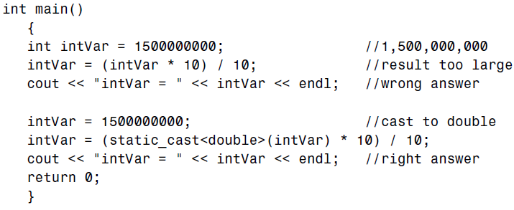

Type Conversions – Casting (contd.)
Taking the previous example again.
Even unsigned int won’t help here.
Upgrade to double.
First output is without casting.
Second is with casting.

Slide 47
Type Conversions – Casting (contd.)
Taking the previous example again.
You could have also initialized your variable to be a bigger data type from the get go.
First output is without casting.
Second is with casting.

Slide 48
Type Conversions – Casting (contd.)
Example of how C++ provides flexibility while developing code.
Normally, casts should not be used.
However, when it is unavoidable, you have an option available.

Slide 49
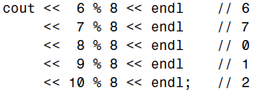
Arithmetic Operators
When doubtful on precedence, consider using parentheses.
Add (+)
Subtract (-)
Divide (/)
Multiply (*)
Remainder (%) // also referred to as the modulus operator
Remainder only works with integers (char, short, int, long).
Note here that the remainder operator has a higher precedence than the insertion operator (<<).
If this were not the case, we would have used parentheses.

Slide 50
Arithmetic Assignment Operators
You can simplify your code using the following syntax.
Total = Total + item;
Total += item; // equivalent to the first statement
Other operators also exist.
-=
*=
/=
%=

Slide 51
Increment Operators
Check this out.
Total++; // postfix variant
++Total; // prefix variant
We can only add 1 using the increment operator.
Also, both variants work differently.

Slide 52
Increment Operators (contd.)
In the following situation, depending on postfix or prefix version, we get different answers.
totalWeight = avgWeight * ++count; // prefix
In this case (prefix), count is incremented first, and then the multiplication is performed.
In the case of postfix (count++), multiplication would have been performed first, and then the increment.

Slide 53
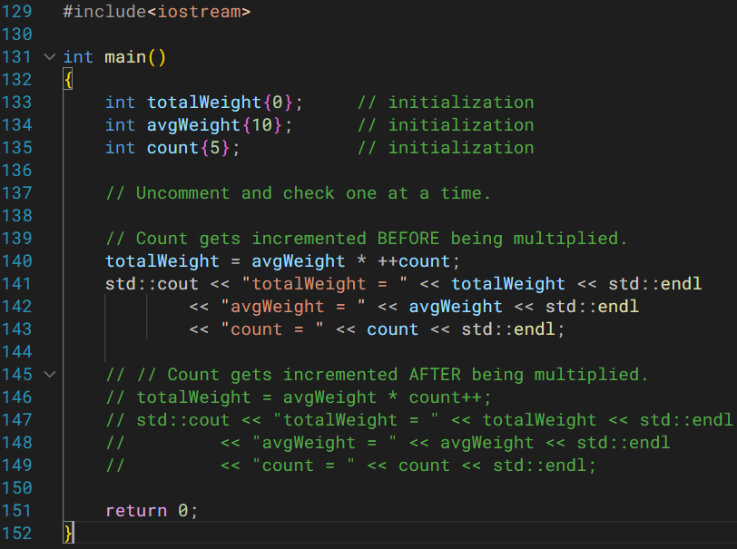
DIY

Slide 54
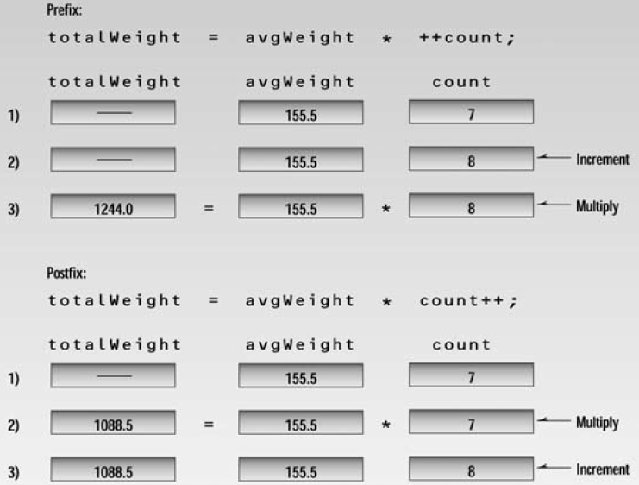
Increment Operators (contd.)
Figure 2.11 from OOP in C++ by Robert Lafore

Slide 55
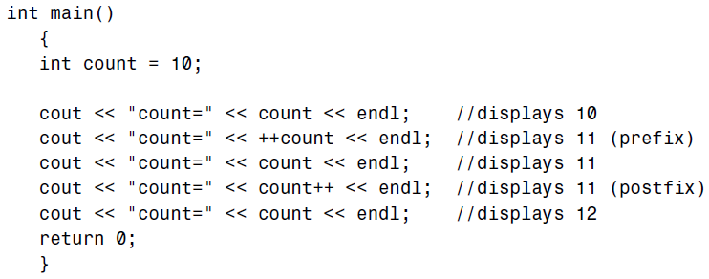
Increment Operators (contd.)
Another good example.

Slide 56
Decrement Operator
Decrement operator works in the same way as the increment operator.
Total--;
--Total;

Slide 57
Precedence
Similar to precedence in arithmetic operators in math.
(num1 – num2) / 2;
num1 – num2 / 2;
Parentheses cause the operations within it to be performed first.
When two arithmetic operators have the same precedence, the one on the left gets executed first.

Slide 58
Expressions
Any arrangement of variables, constants, and operators that specifies a computation is called an expression.
Note: all program statements below are taken from different programs.
sum = num1 + num2; // OK
area = 3.14 * radius * radius; // OK
volume = -3.142 * (radius**3); // ???
Notes:
Not OK.
Use the header file, cmath, and use the function, std::pow()

Slide 59
An Aside… Multiple Declarations
#include<iostream>
int main() {
int num1{12}, num2{2}, num3{-4}; // this is legal
std::cout << num1 << num2 << num3 << std::endl;
return 0;
}
Output on the terminal: ???
Notes:
122-4 // this is the output.

Slide 60
The const Keyword
If you want to keep a value constant, use const.
const double PI {3.14159};
Better readability
Shows the writer and the reader that a certain variable is constant.
Prevents inadvertent change by your code.
Compiler will throw an error if such a value is changed.

Slide 61
std::cout
std::cout is used to print content on the screen.
An object of class ostream.
std::cout corresponds to standard output stream (‘stream’ refers to flow of data).
Standard output stream flows to screen display.
Used alongside an insertion operator, <<.
It inserts the data on its right, to the object on its left.
Notes:
A stream is an abstraction that refers to a flow of data.

Slide 62
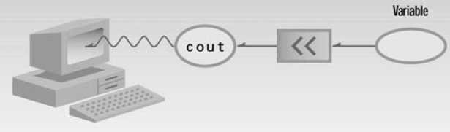
std::cout (contd.)
Figure 2.2 from OOP in C++ by Robert Lafore.

Slide 63
std::cin
std::cin is used to take input from the user.
An object of class istream.
std::cin corresponds to standard input stream.
Standard input stream is user input taken generally from the keyboard.
Used alongside an extraction operator, >>.
It ‘extracts’ the value from the object on its left, and puts it into a variable to its right.
std::cin >> some_num;

Slide 64
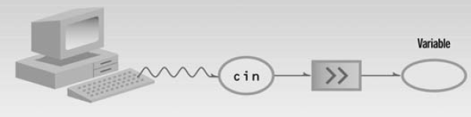
std::cin (contd.)
Figure 2.5 from OOP in C++ by Robert Lafore.

Slide 65
Cascading << and >> Operators
Note that the extraction and insertion operators can be cascaded for added functionality.
#include <iostream>
…
std::cin >> num1 >> num2;
…
std::cout << “This is the sum: “ << sum << std::endl;
…

Slide 66
using namespace std; // Please don’t
Can be mentioned at the top of your file (global scope), or within local scopes (e.g. within the main() function, within an if() block, etc.).
Rule of thumb: learn to avoid using it.
Get in the habit of specifying the namespace whenever you need it.
E.g. std::cout, std::cin, std::endl, std::vector, etc.
Better readability if you specify the namespace.
You know exactly where every function, object, etc. is coming from.
Reduced chances of unexpected behaviors if you specify the namespace.
An example is explained in the following slide.
Notes:
In this course, using this statement won’t impact you much (maybe in the project you might feel the impact), but the idea is to not make writing this statement a part of your muscle memory.
Its usage should be very deliberate and intentional.

Slide 67
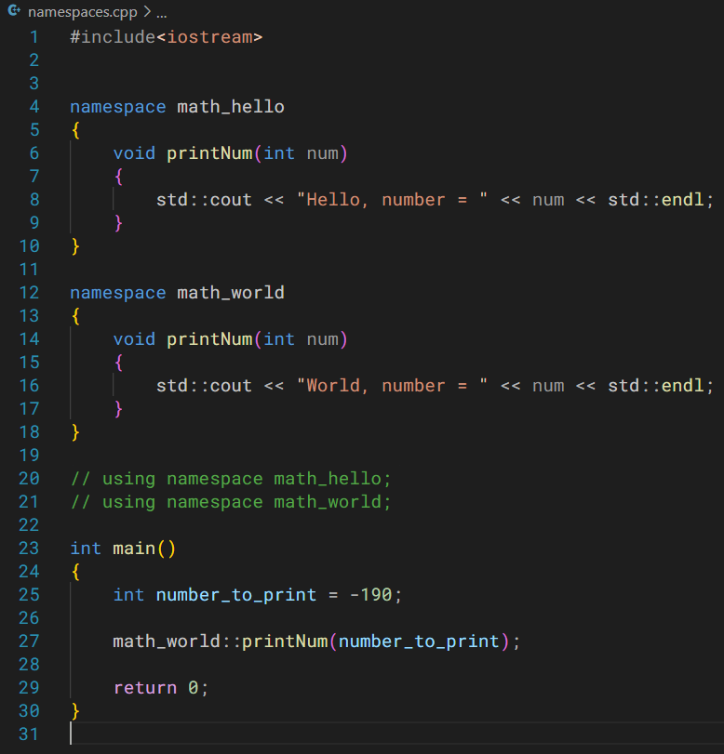
Example
You can find this code in the following source file:
namespaces.cpp
Discussion flow
Global scope
First namespace
Second namespace
Notes:
Global scope: visible everywhere
Let’s say you import a library; that has a namespace; and that has a function.
Now you have another library; that has a namespace; but the function inside has the same name as the function before.

Slide 68
Namespaces
Blocks used to logically organize code.
Primarily, they are very helpful in preventing naming conflicts from occurring.
Like we just saw in the last example, math_hello::print() and math_world::print().
The unique namespaces helped to differentiate between the print() functions.
But when you write, using namespace std; , you, in some sense, are reintroducing the problem of naming conflicts, the very problem namespaces are trying to solve.
You can have nested namespaces as well.
Notes:
There will be situations where using namespace std would be useful, but those situations are generally limited. You can later learn those situations and incorporate this in your coding, but for now, try to build a habit of not using this statement.

Slide 69
Comments
Help the programmer, and people reading your program, understand the program.
Generally should focus on the big picture; the details are in your code.
Are ignored by the compiler.
Two syntaxes (a shortcut on most editors/IDEs -> Ctrl+/)
// single line comment.
/* multi-line
comment */
Comments should not serve as a cover-up for bad code readability however.

Slide 70
Relational Operators True/False Representation
Refer to the following source file.
1- relational_operators.cpp
Relational operators are pretty similar as in Python.
false is represented as zero.
true is represented by non-zero numbers (which means negative numbers as well).

Slide 71
switch if() / else if() / else
Refer to the following source file.
2- switch.cpp

Slide 72
What will be the output of this code?
inside has limited scope; it is only visible within the if() block.
#include<iostream>
int main()
{
int outside{11};
std::cout << "In main()\noutside = " << outside << std::endl;
if (outside < 12)
{
int inside{24};
std::cout << "In if()\ninside = " << inside << std::endl;
}
std::cout << "In main()\ninside = " << inside << std::endl;
return 0;
}

Slide 73
Loops
Refer to the following source file.
3- for_loop.cpp
4- while_loop.cpp
5- do_while.cpp
continue and break work in the same way as in Python.

Slide 74
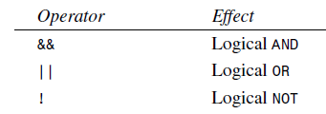
Logical operators

Slide 75
Online Documentation / References
These supplement whatever textbook you’re using very well.
https://en.cppreference.com/w/
https://cplusplus.com/
https://stackoverflow.com/
https://www.learncpp.com/
This last resource is more of an online text book with various chapters and articles.
Free to use.
At the end of each article, there are comments/questions.
You can also send in a question yourself.

